Slide 1
Teaching cybersecurity: a practical path to increase user’s awareness
INJECTION – ADVANCED LEVEL

Slide 2
INJECTION
Injection is an attacker’s attempt to send data to an application in a way that will change the meaning of commands being sent to an interpreter

Slide 3
BEST PRACTICES TO DEFEND AGAINsT INJECTION
Validating user input
Using prepared statements with parametrised queries
Limit special characters
Escaping all user supplied input
Enforcing least previlege
NEVER TRUST USER INPUT

Slide 4
Cross site SCRIPTING ATTACK
Malicious scripts are injected into otherwise trusted websites

Slide 5
XSS
<script> tag
Attributes (onmouseover, oneror…)
Strings with encoded characters
Encode the script in base 64

Slide 6
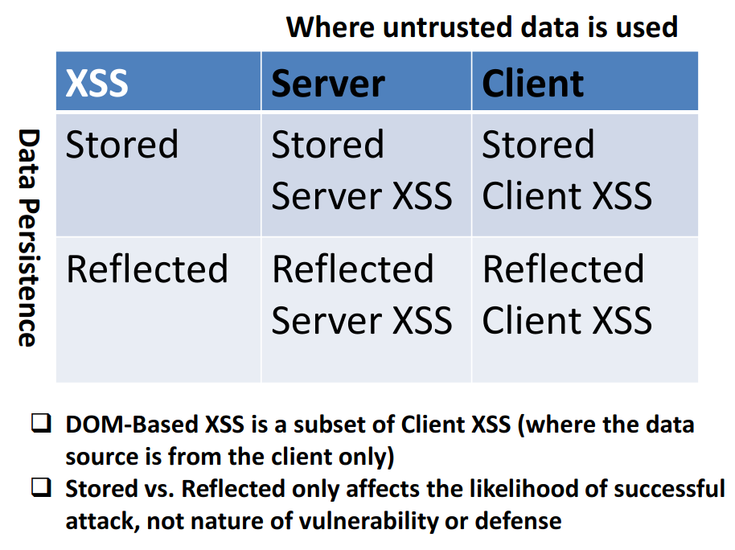
https://owasp.org/www-community/assets/images/Server-XSS_vs_Client-XSS_Chart.png.

Slide 7
BEST PRACTICES TO DEFEND AGAINsT XSS
Validate input data
Ensure variable output is encoded before it is returned to the user
Ensure all variables go through validation and escaping or sanitazation
Turn off HTTP TRACE support

Slide 8
SQL INJECTION ATTACK
Injection of a malicious SQL query via the input data from the client to the application

Slide 9
In band SQLi / Classic SQLi
Inferential SQLi / Blind SQLi
Out of band SQLi

Slide 10
IN BAND SQL Injection
Error based SQLi
Union based SQLi

Slide 11
INFERENTIAL SQL Injection
Boolean SQLi
Time based SQLi

Slide 12
OUT OF BAND SQL Injection
The attacker is not able to use the same channel to launch the attack and to gather the results

Slide 13
SQL injection PREVENTION
Input validation and sanitization
Web application firewall
ORM frameworks
Escape characters
Limit permissions on the database
Use parametrized queries

Slide 14
HAVE FUN WITH SOME PRACTICAL EXERCISES
Complete the suggested exercises of the Advanced Level of the Injection learning path

Slide 15
QUESTIONS
In this little section you will find some simple questions to test your comprehension of the topic.
1. What are the best strategies to use in order to defend against injection attacks?
2. Explain how XSS vulnerabilities can be detected.
3. Explain how you can protect from XSS attacks.
4. Describe the different types of SQL injection.
5. Explain how you can defend against SQL injection attacks.

